Slide 1
Using Online Behavioral Data to Improve Public Health
Henry Kautz
Visiting Professor, University of Virginia
Founding Director, Goergen Institute for Data Science, University of Rochester
Past Director, Information & Intelligent Systems, NSF
January 2023

Slide 2
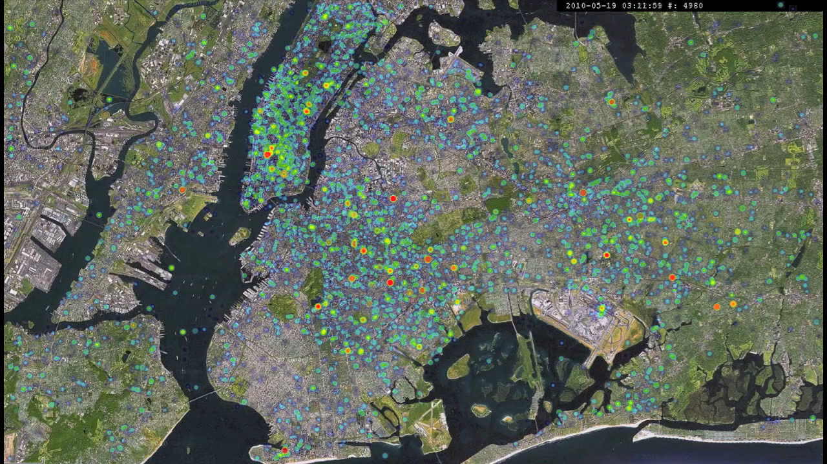
10-Year Retrospective
Using online behavior
  Search, social media, video, …
  Population scale
  Fine granularity
  Timely
  “Organic sensor network”
To answer public health questions
  Who is likely to contract disease?
  What behavioral factors influence health?
  What are environmental sources of disease?
24 Hour Heat Map of Tweets, NYC

Slide 3
Outline
Twitter Health: Predicting Spread of Contagious Disease
nEmesis: Locating Sources of Food-borne Illness
MEW: Mental Health Evaluation using Web Data
Lessons and Next Steps

Slide 4
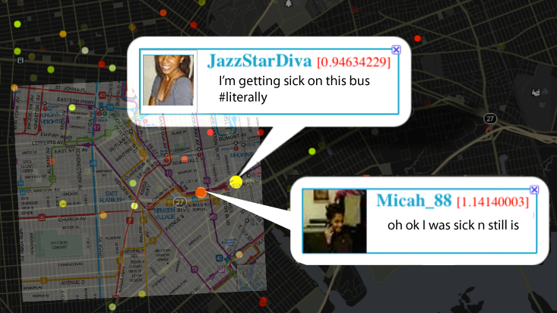
Twitter Health: Predicting Spread of Contagious Disease
2012-2015

Slide 5
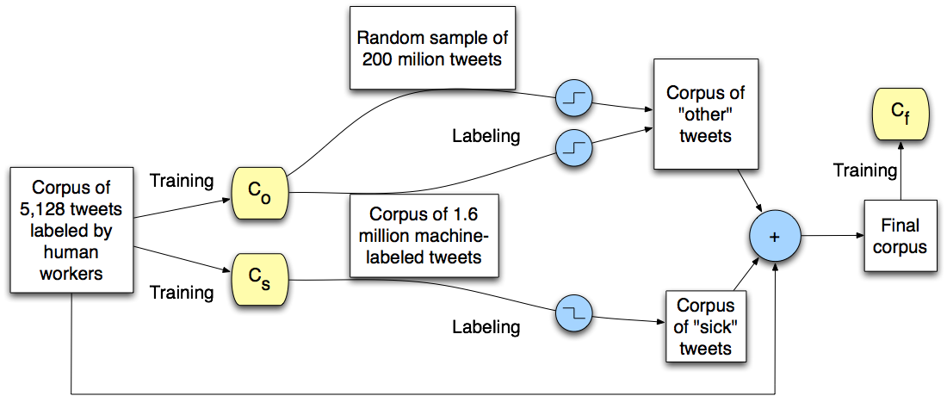
Finding Tweets About Flu Symptoms
Previous work: keywords
  Problems: “sick of homework”, “under the weather”
Our approach:
  Support Vector Machine using word
  trigrams
  Semi-supervised learning using
  Mechanical Turk
  98% accuracy

Slide 7
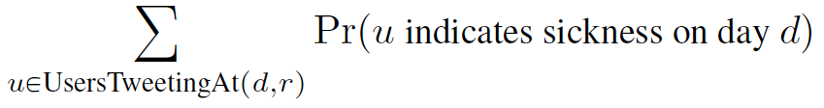
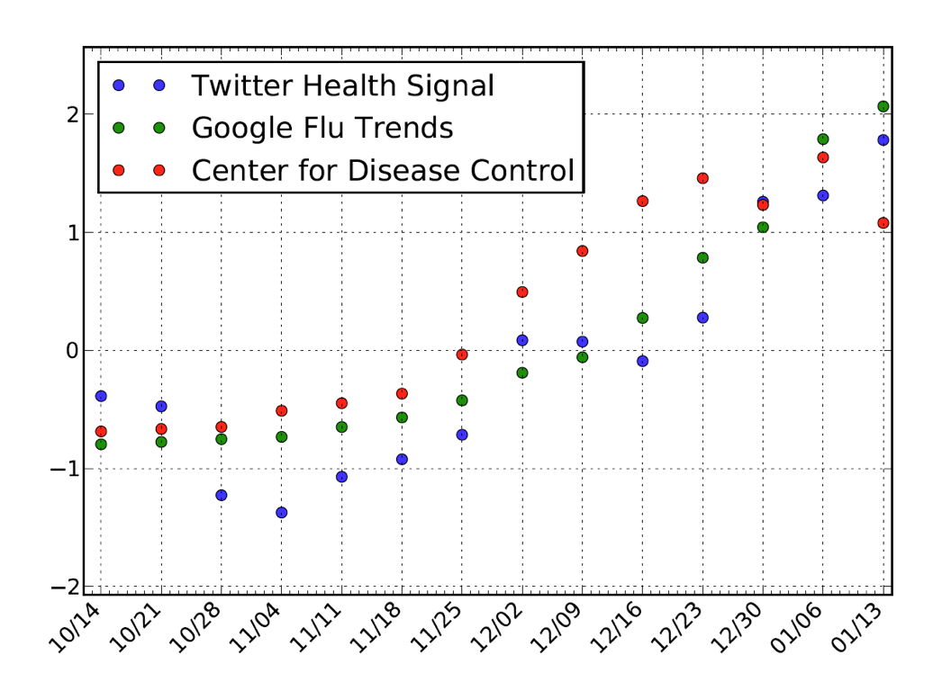
Validating Twitter Health Signal
Change in influenza rate
NYC, Boston, Los Angeles,
Seattle, San Francisco
Correlation with CDC:
R=0.80, p=0.002
Correlation with Google Flu Trends:
R=0.87, p=0.0002

Slide 8
Geolocation Analysis
At time of data collection (2012-2015), most tweets were GPS tagged
Possible to infer an individual’s
  Movement from place to place
  Home location
Enabled prediction of individual developing disease based on
  Encounters with sick-tweeting individuals
  Encounters with sick-tweeting friends (mutual followers)
  Encounters with environmental factors
After 2017, GPS tagged posts became rare

Slide 9
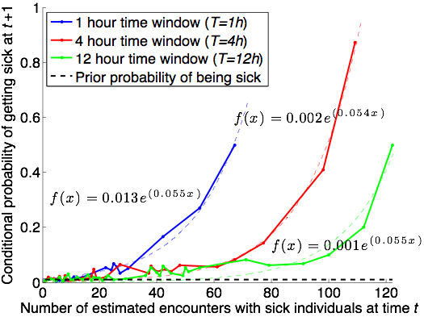
Impact of Co-Location
Impact of encountering 50+ sick users is strong

Slide 10
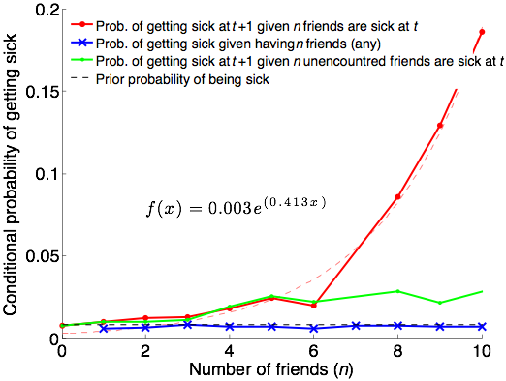
Impact of Friendships
Impact of encountering 8+ Twitter friends is strong

Slide 11
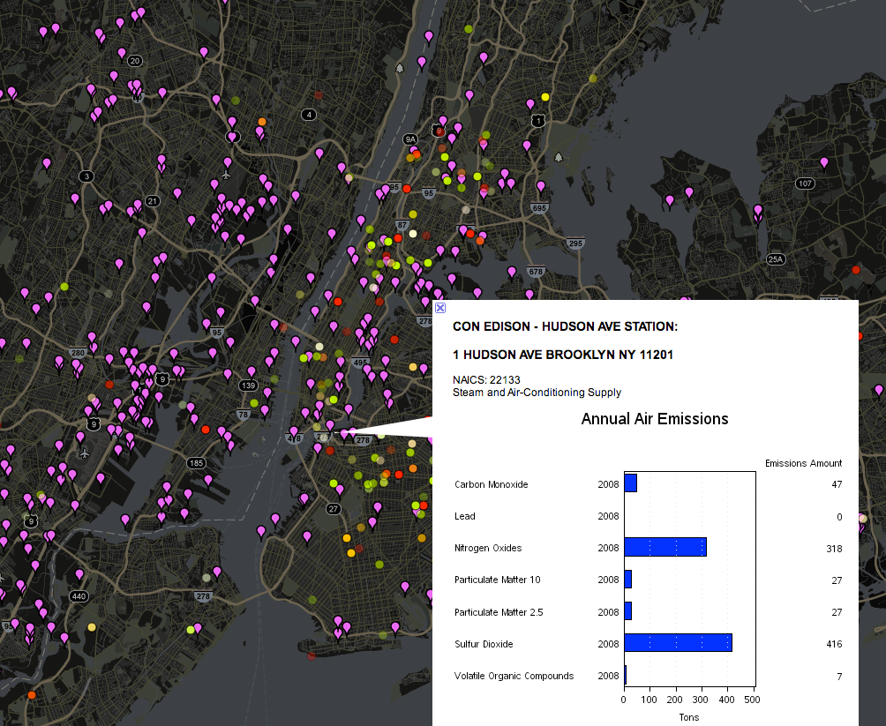

Slide 12
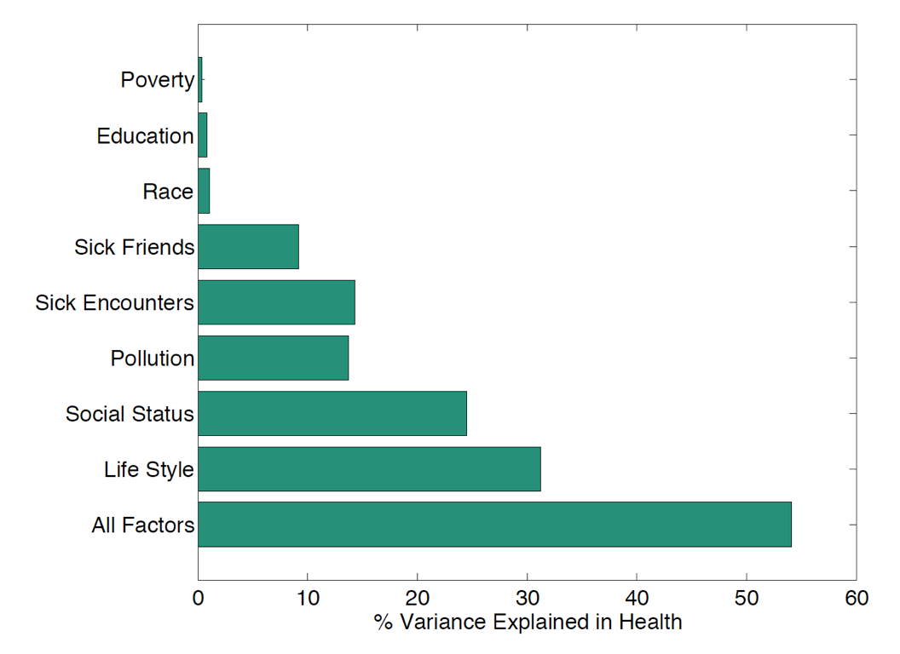
Factors Influencing Health
Regression analysis using factors derived from GPS and social network measures
Fraction of variance in health explained by various subsets of factors
Poverty, Education, and Race are derived from census data for user’s home ZIP code.

Slide 13
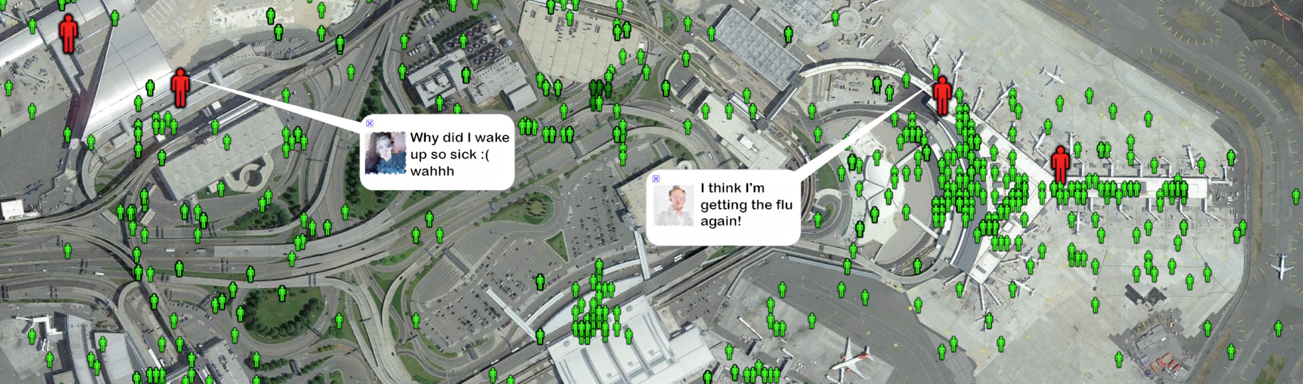
Global Influenza Rate Prediction
Tracked 600,000 Twitter users traveling between 100 metropolitan areas
Regression model predicted weekly influenza rate in a city with high accuracy (within 7% true rate more than 95% of the time) using
  Previous week’s influenza rate for city
  Volume of sick-tweeting users traveling to the city from elsewhere
  Volume of non-sick-tweeting tweeting users traveling to city who had encounters with sick-tweeting users

Slide 14

nEmesis: Locating Sources of Food-borne Illness
2015-2018

Slide 15
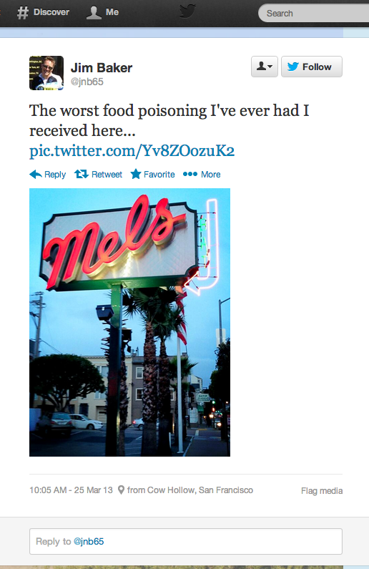
Foodborne Illness
Affects 48 million people annually in US
  128,000 hospitalizations, 3,000 deaths
Primary public health tools
  Licensing requirements
  Inspections of food venues
Challenges
  How can we target inspections more effectively?
  How can we find problematic unlicensed venues?

Slide 16
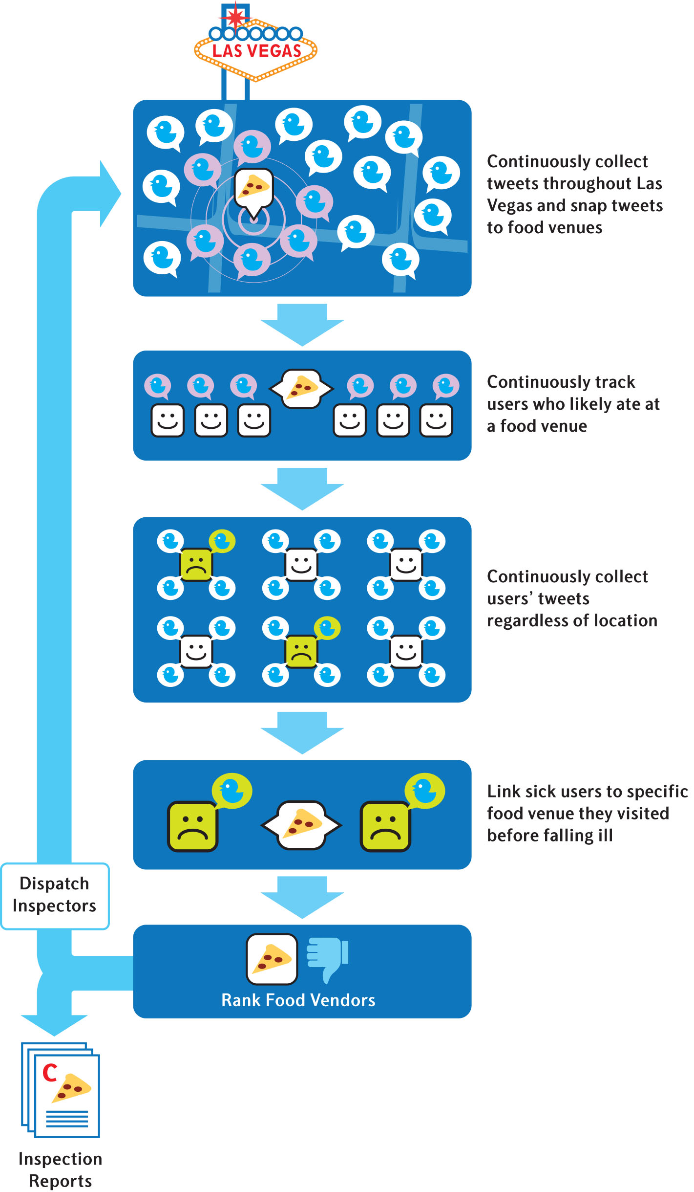

Slide 17
Las Vegas Trial
3-month trial by Southern Nevada Health District (Las Vegas)
Venues with highest predicted risk flagged for inspection
  Paired control venues also inspected
  71 adaptive / 71 control inspections
  Inspectors blind to which are
  adaptive

Slide 18
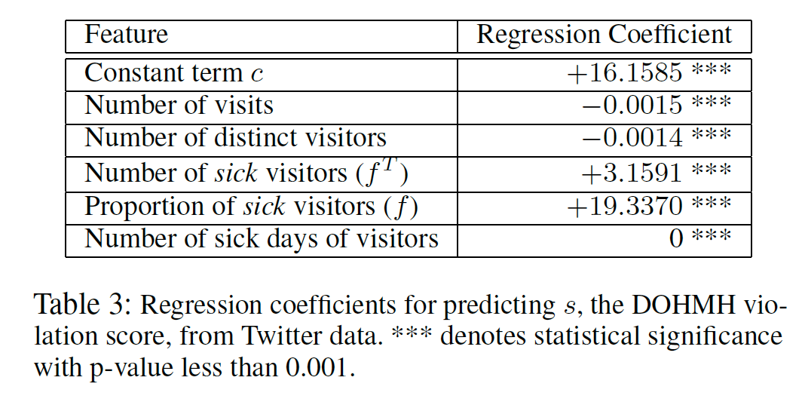
Regression Coefficients for Predicting Violation Score

Slide 19

Results
Adaptive inspections uncover more violations
  9 demerits vs 6 demerits (p = 0.019)
  57% more “C grades” discovered
Adaptive inspections estimated to prevent 71 infections and 4 hospitalizations during trial
nEmesis alerted health department to an unlicensed seafood venue
System replicated with similar results using Google search data instead of Twitter
  Chicago and Las Vegas
  Sadilek et al., npj Digital Med 1, 36 (2018)

Slide 20

MEW: Mental Health Evaluation from Web Data
2019-2021

Slide 21

Prevalence of Mental Illness
25% of adults suffer from mental illness
  4% highly serious - schizophrenia, bi-polar, major depressive
  Most common: depression and anxiety
Large increase in mental illness about among high-school and college-age youth since 2019
  30% increase in emergency room visits
  Rates of depression and anxiety doubled
  Accelerated 2-decade long upward trend
Most mental illness is untreated
  60% if youth with major depression receive no treatment
Notes:
In US 1 in 5 individuals experience some form of Mental illness every year
50% of these begins by age 14
National Institute of MH estimates that only 40% people who suffer from mental illness seek help
Clearly mental illness is a major public health concern, that can:
Affect the course of other medical conditions and diseases
Incur great cost from economic standpoint

Slide 22

Challenges to Diagnosis
Traditional assessment requires patient to proactively
find, engage with, and pay for a healthcare professional
Mental illness symptoms may be triggered by life events
  Not visible by the time a patient is assessed
Reliance on patient self-report makes diagnosis difficult when patient unintentionally or deliberately conceals information
Can we create a scalable way to continuously screen a population for potential mental health concerns?

Slide 23




Why Not Rely on Public Social Media Data?
Many researchers have attempted to derive a mental health signal from users’ social media posts
  Young adults spend 8 hours a day online
Limitations
  People frequently self-censor and deliberately create false self-images on social media
  Studies rarely have access to ground truth of subjects’ mental health
  Predictions are not actionable
  Require access by media site researchers to proprietary data or break terms of service
  Have provided no general, scalable, and privacy-preserving data collection tools
Notes:
Social media data has been the most popular form of information that has been studied in the research community to model and understand various aspects of MH conditions
However, social media data has its challenges: self selection bias, sensoring contents, posting things that are socially acceptable, fear of stigma
data is only gathered from users of particular social media sites.
Because users self-select for particular sites, there may well be confounding factors that influence both the users’ mental health and their online behavior.

Slide 24
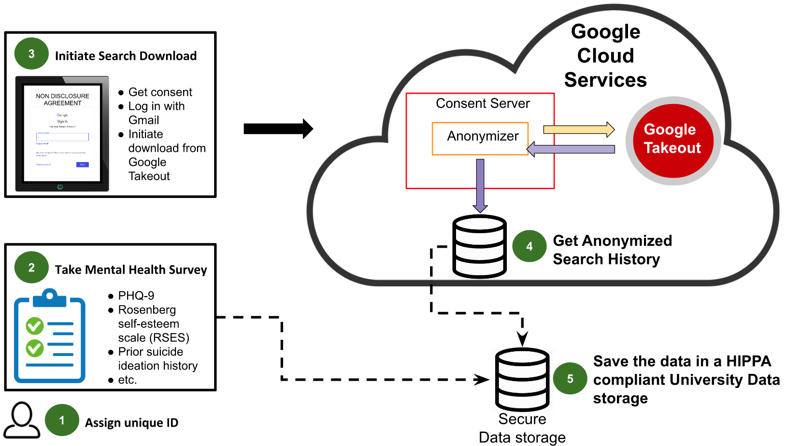
Mental Health Evaluation Using Web Data (MEW)
Hypothesis: Subjective Experience → Online Behavior
Focus on non-demonstrative behavior
  Search
  Media consumption
Scalable platform for consenting subjects to provide access to their data
  Full protection of subjects’ rights
  No violation of websites’ terms of use
  Gather ground-truth at time of consent
Secure, privacy-preserving analytics
  For scientific research
  For clinical use
Notes:
We hypothesize that routine experiences in our life invoke certain online behaviors
In our work, we aim to study individual level search engine logs, a data source that has not been used in the past to assess individual level MH phenomenons
Through our proposed framework, we aim to show that individual level longitudinal ground truth data can be merged with online activities from Google Search engine and YouTube search engine to study various forms of MH conditions

Slide 25
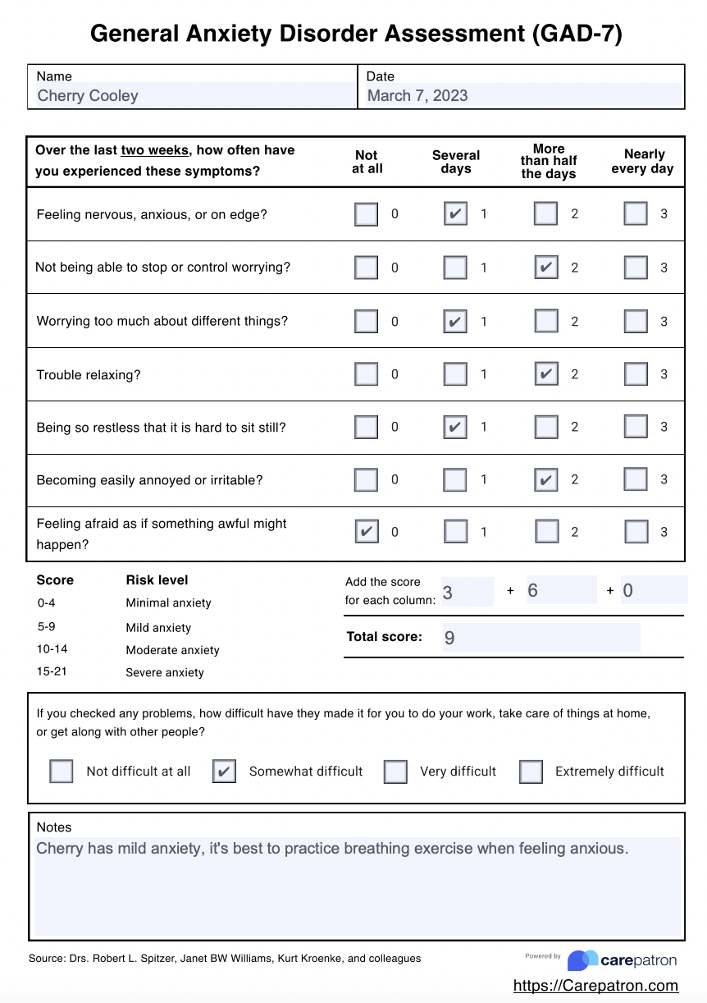
Data Sources
Ground truth
  Age, gender, academic, demographic
  Depression: Patient Health Questionnaire (PHQ-9)
  Anxiety: Generalized Anxiety Disorder (GAD-7)
  Rosenberg Self-Esteem Scale
Online behavior: Google Takeout
  Google search history
  YouTube viewing history
  Chrome browser history
  GPS history
  Google Photos …
Notes:
2nd component of our data: the ground truth mental health information
we collect via the survey University’s Red Cap system allows us to easily design questions and collect data
We gather:
Age, gender, demographics info
For Mental health we use clinically validated psychological instruments as surveys
PHQ (0-27)
ROS(0-30)
GAD7(0-21)

Slide 26
Mew Platform
Notes:
A big picture overview of the whole data collection process for a particular individual

Slide 27
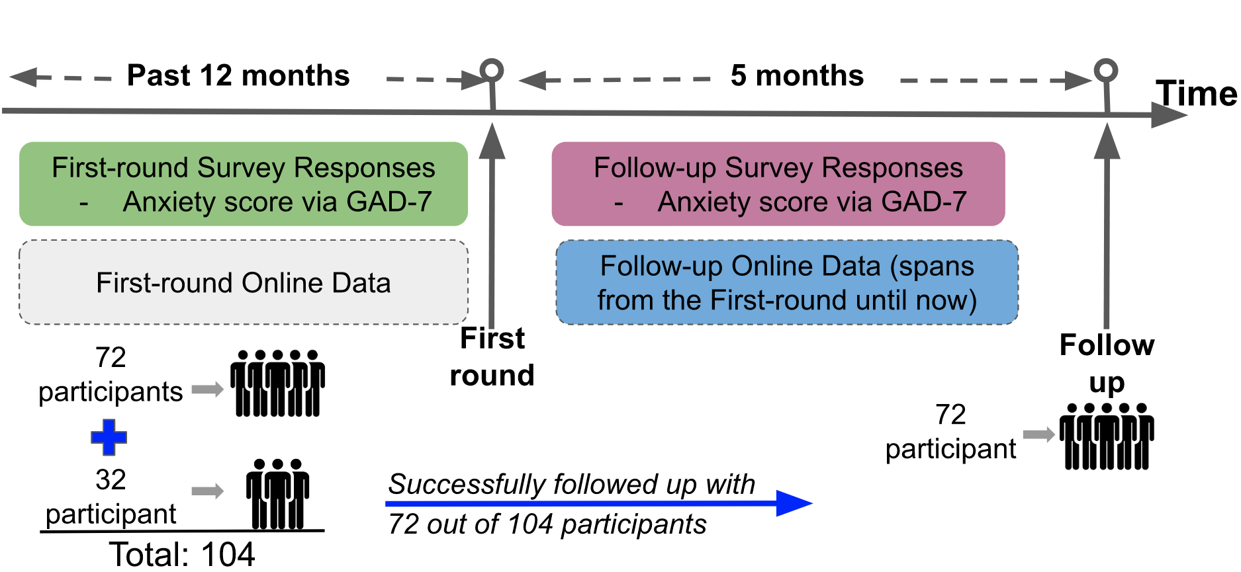
Anxiety Detection & Prediction Longitudinal Study
Given online data at time T, detect anxiety (GADS-7>9) at time T
Given GADS-7 score at time T1 and online data at times T1 and T2, predict GADS-7 score at time T2
Notes:
Anxiety disorder is one of the world’s most prevalent mental health conditions (WHO reported)
Current methods: in-person interviews, which is expensive, time-consuming, and blocked by social stigma
In this work, we can identify an individual suffering from potential anxiety disorder and even more, we can predict their level of anxiety score based on YouTube and Google Search log histories
IMPORTANT: GAD-7 survey questions were used to get ground truth anxiety assessment of the participants

Slide 28
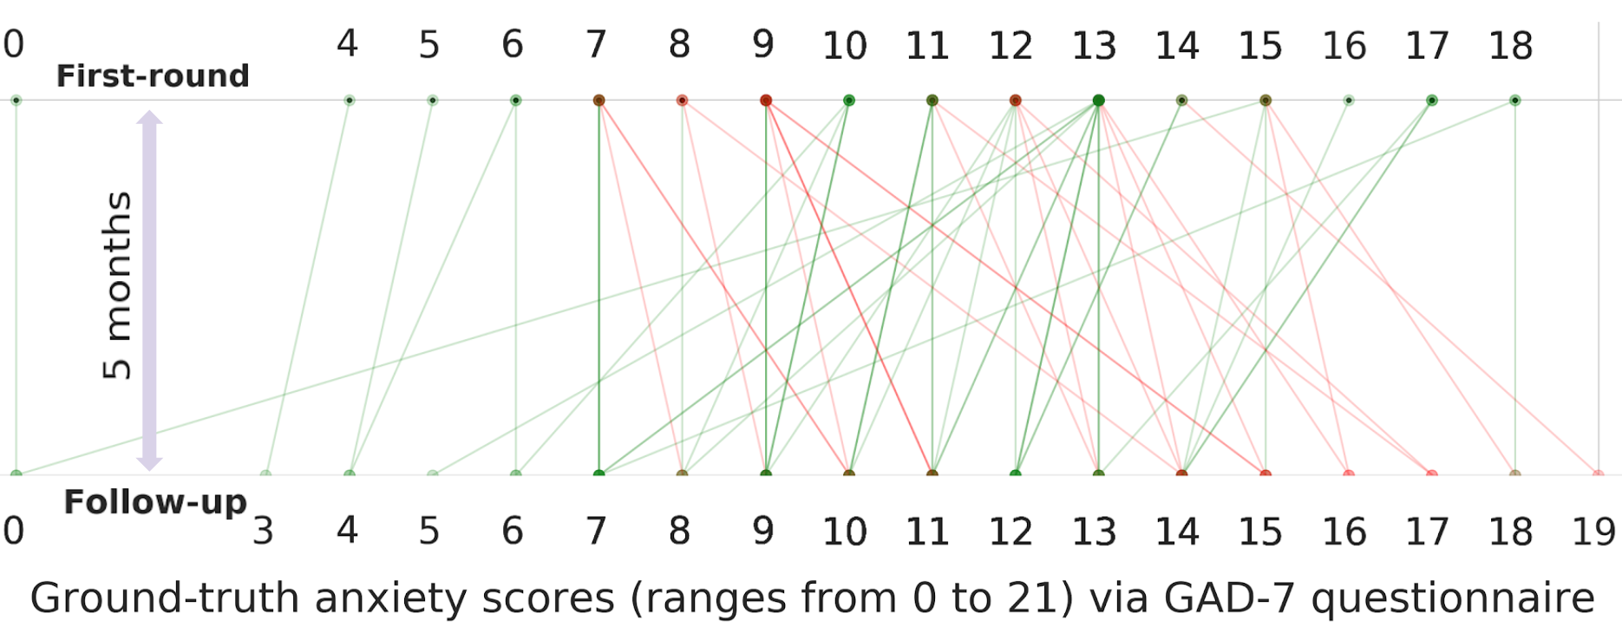
Anxiety Scores Between Rounds
Score Increased (22), Decreased (32), Unchanged (18)
Notes:
We observed that the anxiety score increased for 22 individuals,decreased for 32 people, and remain unchanged for 18 participants

Slide 29
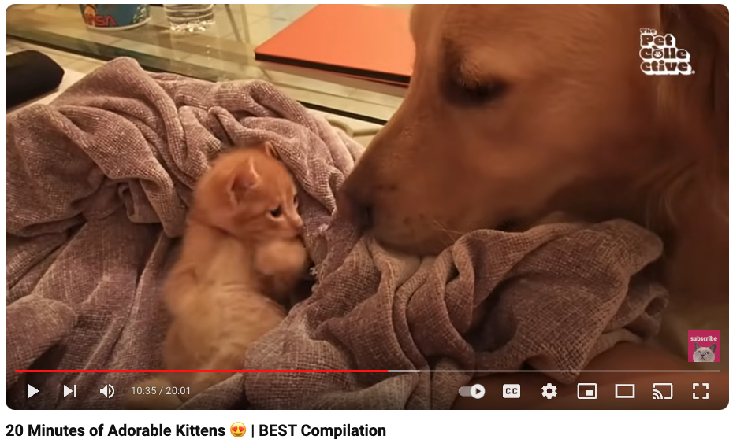
Online Data Features
Google search search queries → category labels using Google Cloud NLP API
  “election results” → NEWS
YouTube videos → YouTube category label
  “20 Minutes of Adorable Kittens” → PETS & ANIMALS
Timestamps of activities
Temporal distribution of activities

Slide 30
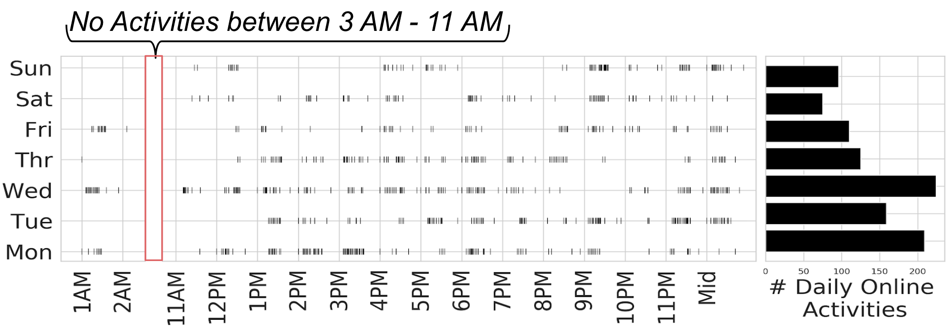
Example Daily/Weekly Activity Distribution
Notes:
This is an example of a person’s 1 week google and youtube activities!
Each row is a day, and each ‘|’ bar represents a single online activity.
The histogram on the right side show the total online activities for each day.
Notice the burstiness of daily online activities.
Activities drop during weekends
People are probably spending less time interacting on internet and more time relaxing, socializing, and connecting with others around them

Slide 31
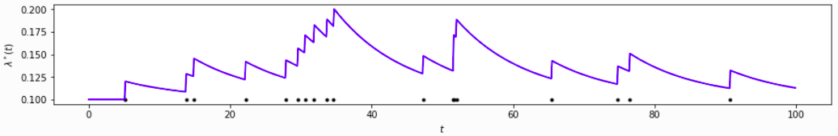
Derived Features
Daily and weekly activity mean and variance
Temporal point process parameters – captures “burstiness” of activity
Categorical entropy – how varied are category labels
Mode of inactivity midpoint

Slide 32
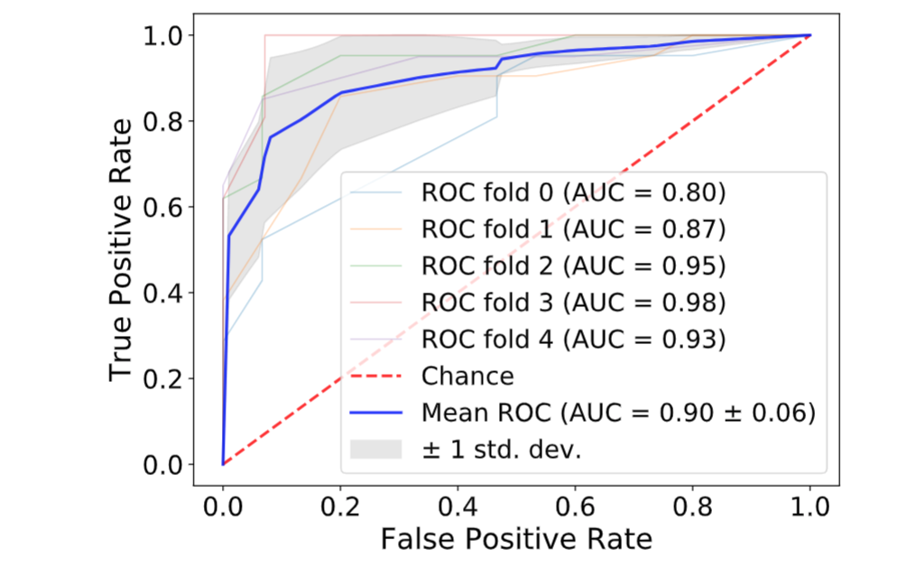
Task 1
Given online data at time T, detect anxiety (GADS-7>9) at time T
Random Forest
5-fold cross validation
Notes:
Since RF performed the best, we plotted the ROC for the RF
The area under the curve, called AUC, tells us how well the model is performing
AUC goes from 0 to 1. 1 → mode is perfect

Slide 33
Task 2
Given GADS-7 score at time T1 and online data at times T1 and T2, predict GADS-7 score at time T2
Added derived features to capture changes in online behavior
  Xi = vector of features for categories, inactivity, and burstiness for time Ti
  ΔX = X1 – X2
Compared ordinary least squares (OLS), gradient boosting (GB), and Gaussian process regression (GP)
Notes:
Switching gear to predicting anxiety scores from YouTube and Google Search
Concretely, given the two rounds of data, we aim to predict the GAD-7 score in the follow-up round given the online history data and the GAD-7 score from the first-round
We want to predict y₂, given x₁, y₁, x₂
X₁ first round online data and y₁ = first round anxiety score,
x₂ follow up round online data and y₂ = follow-up round anxiety score
Delta X = X₁ - X₂ = change in online behavior
Our assumption is that change in online behavior may preserve some info about change in anxiety levels

Slide 34
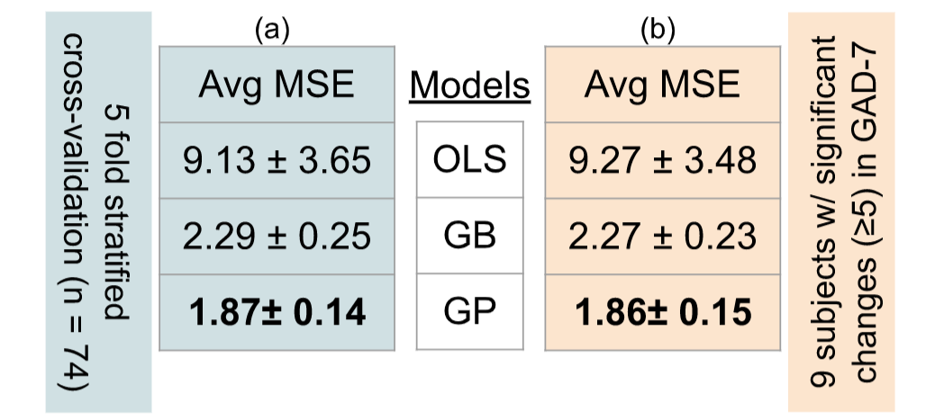
Predicting GADS-7 Anxiety Score (0 to 21)
Notes:
Since regression, we use avg MSE as the metric to assess how well the models are performing.
Lower the MSE, the better.
Carried out 5 fold cross val (used only the participants who participated both during the first and follow up round, n = 74)
GP out performs both OLS and GB
NOW:
There were 9 individuals whose anx score changed significantly(>=5) between the two rounds
We want to see how well the models do on them
As we did the 5 fold cross val, we ensured that those 9 folks are always in the test test
Column (b) shows the avg MSE metrics for the models when we followed this process
Basically, shows that GP is quite flexible in capturing significant changes in GAD-7 scores (b)

Slide 35
Lessons and Next Steps

Slide 36
Lessons
Accurate measures of communicable disease, environmental hazards, and mental health can be inferred from online behavior
Significant features
  Semantic
  Temporal
  Latent
It is now difficult to obtain research access to social media – but online activities not based on explicit user sharing can be highly informative
Rules of human-subjects consent provide an intellectual framework for ethical data-collection and evaluation

Slide 37
Next Steps
MEW framework in other research settings and for other conditions
  Substance abuse
  Healthy diet
Extend to data sources beyond Google Takeout
  Tik-Tok and Instagram viewing history
Go beyond disease detection/prediction to tools for treatment
  Therapist Dashboard: provide therapist with a snapshot of relevant client behavior when not in therapy sessions

Slide 38
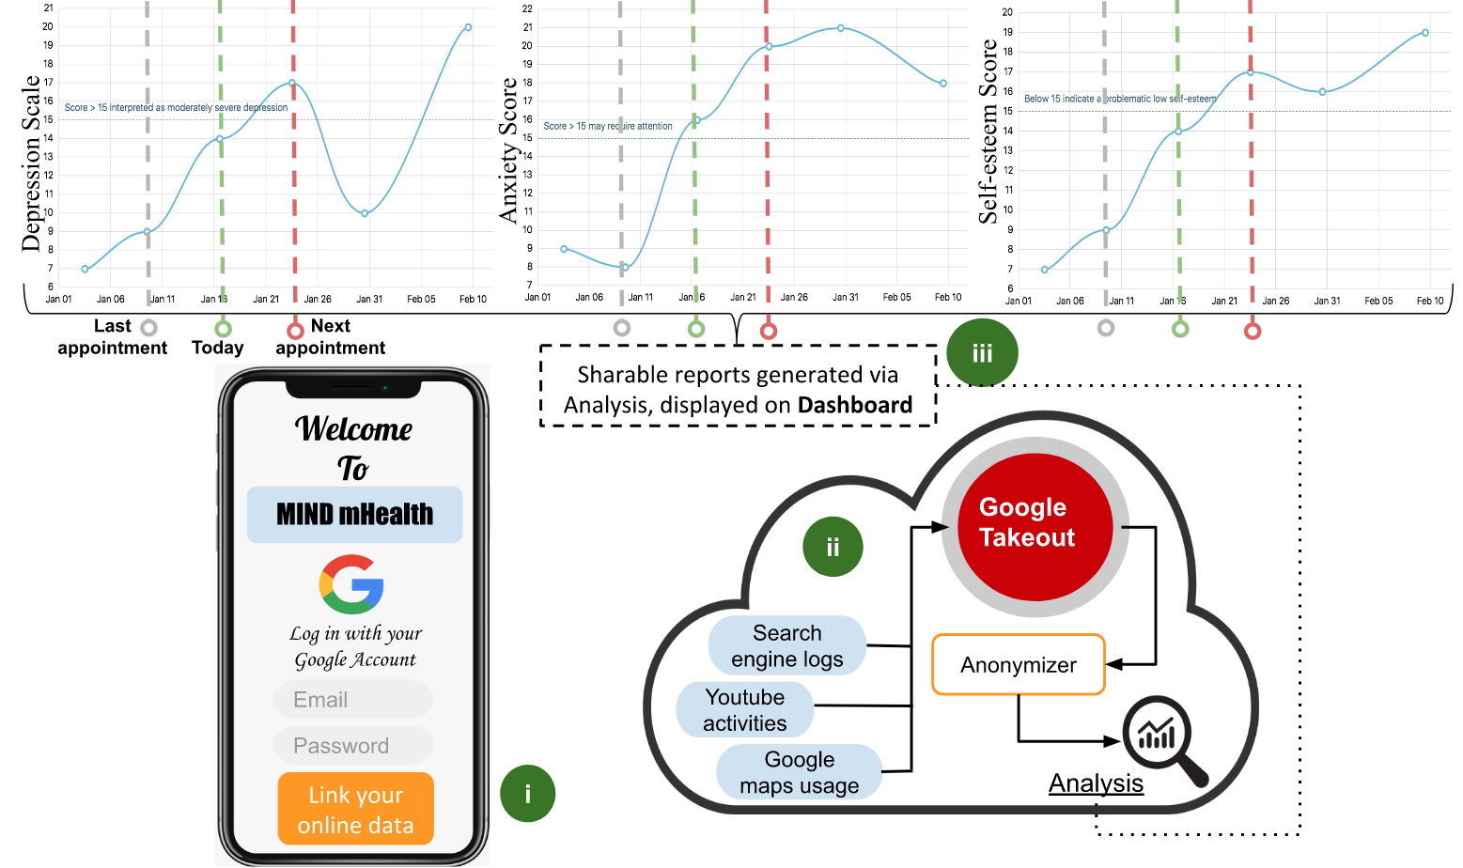
Notes:
Imagine an application that taps into your online activities and constantly assess your depression, anxiety, and self-esteem level
Your therapist/counselor has access to these plots
These plots are generated live!

Slide 39
Other Interests
Satisfiability testing & constraint satisfaction
Neuro-symbolic systems
AI for science
AI for culture and history
Jazz and blues
  https://wayofm.org/shows/roots-jazz-and-blues-king-henry

Slide 40
Thanks to students Adam Sadilek, Anis Zaman, and Boyu Zhang, and colleague Vincent Silenzio
Papers at https://henrykautz.com/research

Slide 41
Modeling Online Activity Temporality

Slide 42
Gaussian Process Regression (1)

Slide 43
Gaussian Process Regression (2)

